Slide 1
Secure Hybrid & Multi-Cloud Environments
Microsoft Defender for Cloud
Protect your multi-cloud and hybrid environments
SALIN KUMAR C S
Sr. Pre-Sales Consultant Microsoft Cloud
Redington MEA

Slide 2

Cloud security challenges
Visibility into security and compliance
Increase in number and sophistication of attacks
Complexity managing multi-cloud environments
52% of organizations cite secure configuration of cloud resources as a top priority.¹
​In 2024, the average cost of a breach was $4.24M.²
92% of organizations are embracing a multi-cloud strategy
¹Source: 451 Research
²Source: Ponemon Institute, Cost of a Breach Report
Notes:
While the shift to the cloud has become a strategic direction for most organizations, it comes with a unique set of security challenges.

Slide 3









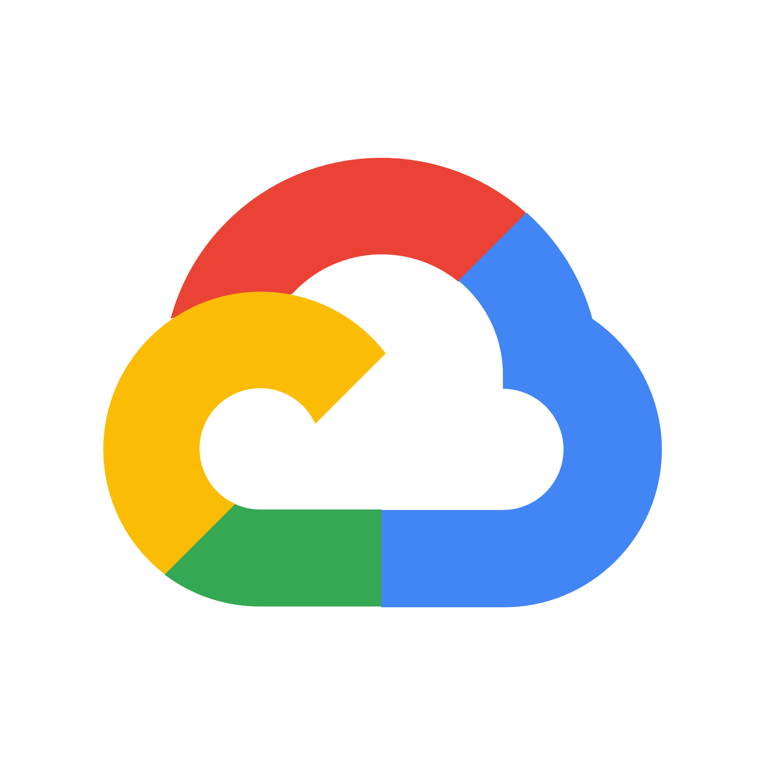
Microsoft Defender For Cloud Cloud native application protection across clouds and on-prem environments
Harden and manage your Security Posture
Detect threats and protect your workloads
Respond & Automate
Automate with the tools of your choice
Secure configuration of resources
Full-stack threat protection
Assess and resolve security alerts and incidents
Management of compliance requirements
Vulnerability assessment & management
Automate response
Microsoft Azure
Amazon Web Services
Google Cloud Platform
On-prem
Notes:
Microsoft Defender for Cloud is a solution for cloud security posture management (CSPM) and cloud workload protection (CWP) that
finds weak spots across your cloud configuration,
helps strengthen the overall security posture of your environment,
and can protect workloads across multicloud and hybrid environments from evolving threats.
It supports multicloud and hybrid environments and integrates with a range of products to enable seamless response and automation for your SecOps teams.

Slide 4
How we’re different
Built-in
with Azure
No deployment, just enable
Built into the resource provisioning process
Broadest protection coverage
Remediate with a click
Multi-cloud and hybrid support
Agentless onboarding for AWS and GCP posture management
Auto provisioning for new resources
Onboard on-prem resources with Azure Arc
Secure Score
Birds-eye view of the security posture of all your clouds
Prioritized security recommendations
Track and manage your security posture state over time
Advanced Threat Protection
Workload-specific signals and threat alerts
Deterministic, AI, and anomaly-based detection mechanisms
Leverages the power of Microsoft Threat Intelligence with 24 trillion signals daily

Slide 5
Make Microsoft Defender for Cloud work for you
Chief Information Security Officer
Security Admin
Security Operations
Responsibilities
Create an overall security strategy that creates resilience against cyber attacks and track performance over time
Product use cases
Top level view of the multicloud security state
Create dashboards to visualize progress over time
Responsibilities
Reduce the attack surface of the organization’s cloud environments
Product use cases
Harden the cloud environment with recommendations
Set security policies for the environment, monitor implementation, track down vulnerabilities
Manage the multicloud asset inventory
Responsibilities
Around the clock threat hunting, investigation of breaches, and mitigation of incidents
Product use cases
Leverage workload-specific threat detections and response mechanisms to identify attacks, investigate alerts and incidents, and quickly mitigate threats
Notes:
Guidance: Tailor talk track depending on your audience/role of your customer contact

Slide 6
Harden and manage your Security Posture

Slide 7

Holistic management of your security posture in the cloud
Resource visibility
Secure Score
Compliance
Data security
View and manage your cloud resource inventory
Understand the bottom line of your security posture, implement recommendations, and monitor over time
Ensure your configurations align with key compliance standards
and enforce organizational policies
Identify sensitive data and prioritize critical resources
Notes:
Managing your security posture in the cloud is critical to prevent breaches and shield your corporate assets from attacks.
Microsoft Defender for Cloud uses 4 key concepts to provide Cloud Security Posture Management (CSPM)

Slide 8
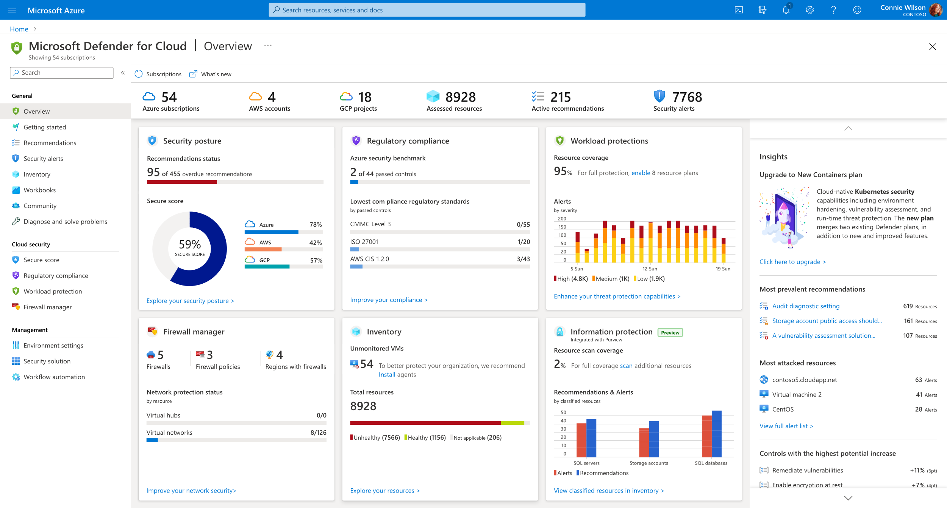

The security dashboard
Centralized posture view
Your security posture across Azure, AWS, and GCP in one place
Focused views
Easily access deep dive views for security posture, resource inventory, workload protection, and more
Top insights front and center
Understand which recommendations to prioritize
See your most attacked resources and take action
Notes:
The Security dashboard is your entry point in Microsoft Defender for Cloud with a high level status overview into all relevant functionalities of the product

Slide 9
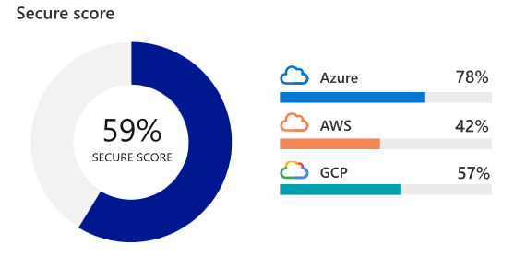





Secure Score
Assess and implement best practices for security and compliance
Cover all critical cloud resources across network, access, compute, databases, your service layer and more
450+out-of-the-box recommendations
Create custom recommendations to meet organizational requirements
Use “Quick fix” to remediate with a single click or scale enforcement mechanisms to enforce policies to avoid configuration drifts
Evaluated categories
Access
Compute
SQL server
IoT
Network
App Services
Containers
Notes:
You may be familiar with the concept of Secure Score from other Microsoft products. It’s a centralized view and tracking mechanisms that shows the current security state of your cloud environments.

Slide 10
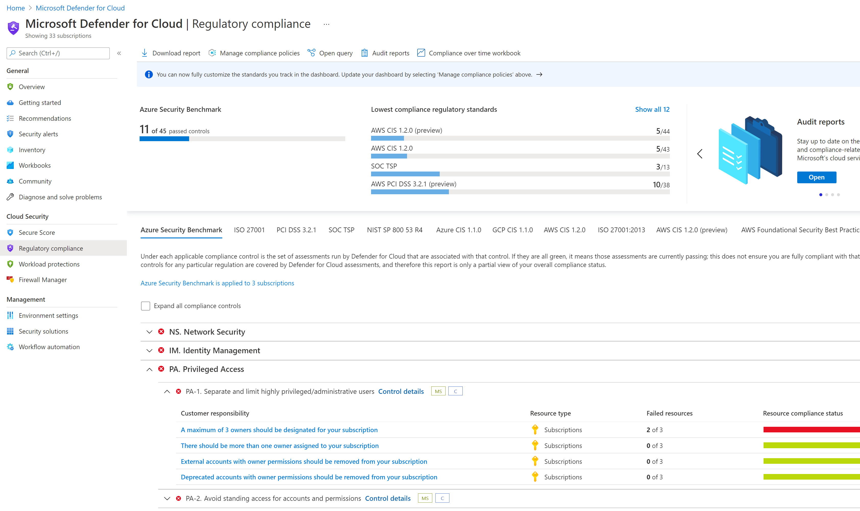
Compliance assessment and management
Assess and manage your compliance status with a continuous assessment of your cloud resources
Use industry standards, regulatory compliance frameworks, and vendor provided benchmarks to implement security and compliance best practices
Create custom recommendations to meet unique organizational needs
Support for:
CIS
PCI
NIST
SOC
ISO
HIPAA
Local/National compliance standards
Azure Security Benchmark
AWS Foundational Security best practices
Notes:
Monitor compliance
Security assessments mapped to compliance controls and requirements, enabling aggregated view of compliance status.
The Azure Security Benchmark is always monitored in the dashboard by default, and is fully aligned with Secure Score (contains the same set of recommendations). Therefore, resolving those recommendations helps to meet the control requirements and helps raise your Secure Score at the same time.
The dashboard is dynamic, so you monitor exactly the set of standards that are important to your organization. You can also onboard custom standards to the dashboard, and define your own custom control set.
Reports can be downloaded for each standard, and you can choose from an executive level PDF report and a detailed CSV report.
Manage organization security policy and compliance
It's a security basic to know and make sure your workloads are secure, and it starts with having tailored security policies in place. For Azure, all recommendations are built on top of Azure policy controls, so you're getting the full range and flexibility of a world-class policy solution. In Microsoft Defender for Cloud, you can set your policies to run on management groups, across subscriptions, and even for a whole tenant.

Slide 11
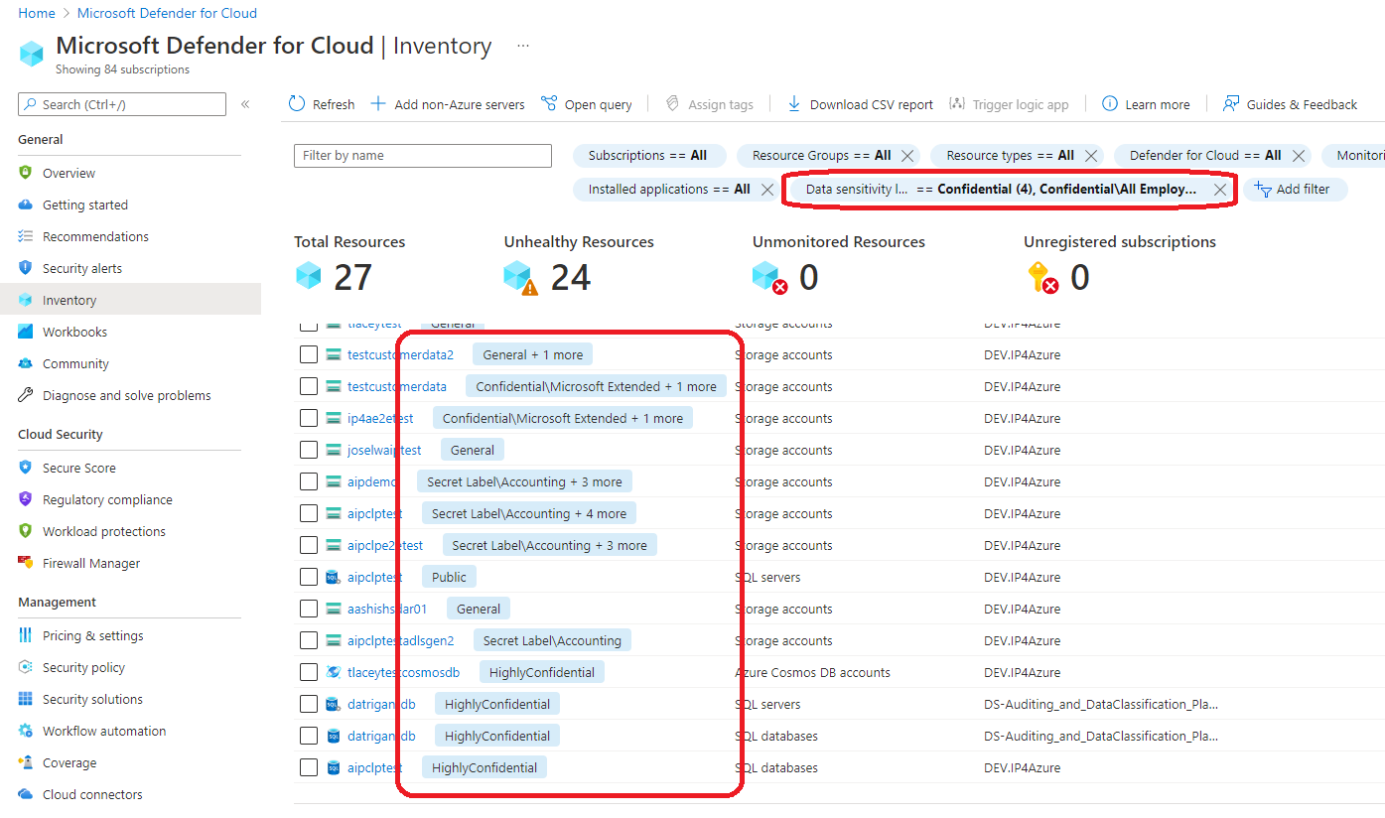

Identify sensitive data in cloud resources
Integrated with Microsoft Purview
Extend visibility from cloud infrastructure resources into the data layer
Leverage an entirely new way to prioritize security policies and the investigation of alerts
Filter recommendations and resources by data sensitivity
Easily view the number of assets that contain sensitive information across your environment
Notes:
Data resources remain a popular target for malicious actors, making it crucial for security teams to identify, prioritize, and secure sensitive data resources across their cloud environments.
To address this challenge, we’re excited to announce the integration between Microsoft Defender for Cloud and Azure Purview in public preview. Azure Purview is a unified data governance service that provides rich insights into the sensitivity of your data within multi-cloud, and on-premises workloads.
The integration with Azure Purview extends your security visibility in Defender for Cloud from infrastructure resources down into your data, enabling an entirely new way to prioritize resources for security teams.
For an enriched CSPM experience, we included an Information protection tile in Defender for Cloud that shows your current scan coverage and a graph with the number of recommendations and alerts by classified resource types. In addition, we created two new filters in the Defender for Cloud Inventory experience and within Security alerts called Data sensitivity classifications and Data sensitivity labels. These new options allow security teams to filter specifically for sensitive data and more effectively prioritize the enforcement of security policies and the investigation of alerts across the most sensitive resources.
Lastly, the Resource Health blade now provides additional metadata classification details at the resource level, giving you with an easy way to view the number of assets that contain sensitive information across your environment.
value prop: the integration with Azure Purview extends your security visibility from your resources/infrastructure down into your data.
how: data sensitivity classifications and data sensitivity labels enable security teams to prioritize security and remediation of unhealthy resources which contain sensitive data.
Perfect, adapted the section thanks!

Slide 12
Detect threats and protect your workloads

Slide 13
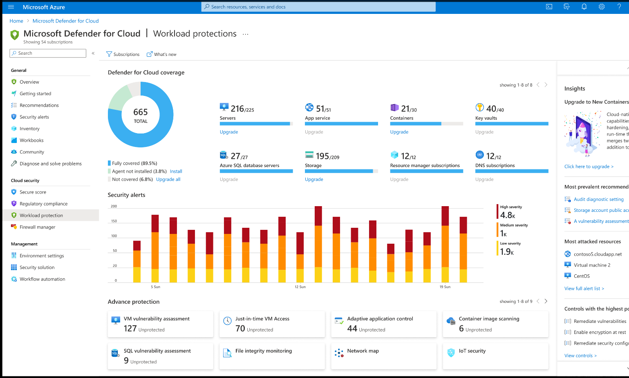
Protect your workloads in the cloud and on-premises
Use detections that are built for the unique attack vectors of each resource type, built on the powerful insights of Microsoft Threat Intelligence
Reduce your attack surface by continuously scanning workloads to identify and manage vulnerabilities
Automatically protect new workloads as soon as they are deployed
Integrate with your SIEM for easy management of incidents

Slide 14
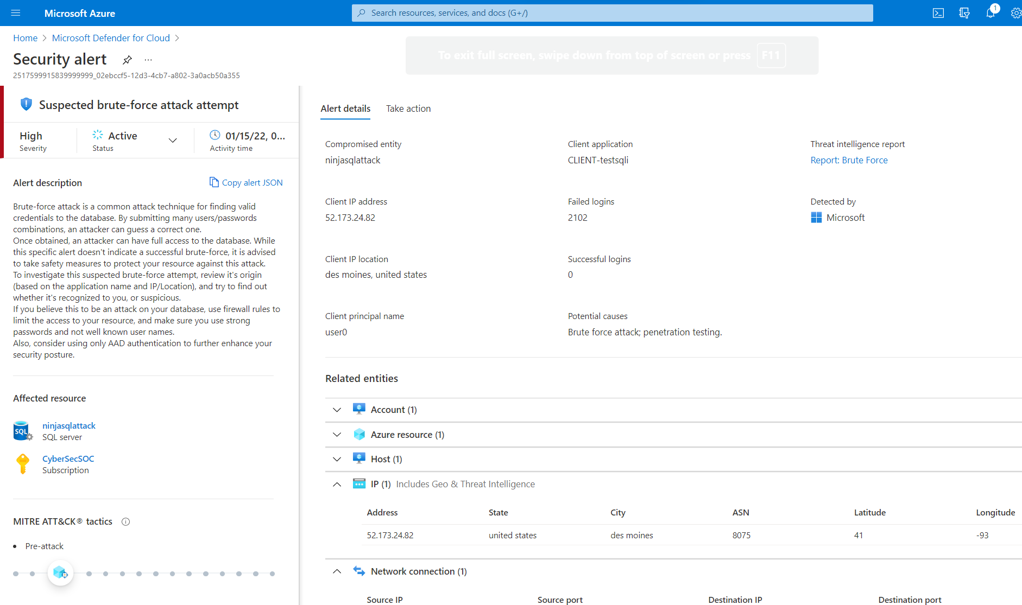
Security alerts and incidents
Use prioritized alerts when threats are detected on your resources.
Investigate effectively with smart alert correlation that combines different alerts and low fidelity signals into security incidents.
Manage incidents with a central view of attack campaigns and related alerts.

Slide 15









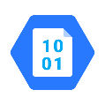


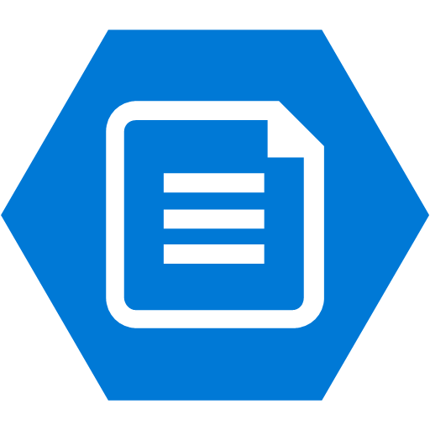






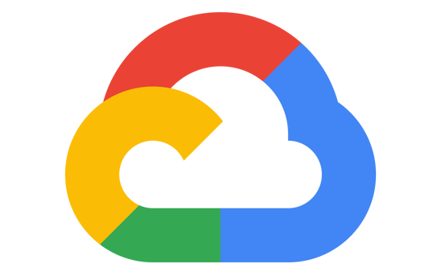
Full-stack coverage with dedicated detections
Compute
Service Layer
AWS workloads
GCP workloads
Any server
Azure VMSS
Azure DNS
Key Vault
App Services
Azure K8s
Network Layer V1
Resource Manager
Amazon EKS
GKE clusters
Databases and Storage
Blob storage
File storage
Maria DB
Azure Cosmos DB
Amazon EC2
Google Compute
Azure SQL
MySQL
Postgres SQL
Azure Resource Management
Notes:
Microsoft Defender for Cloud uniquely protects a very wide range of workload types in Azure and those native to AWS and GCP.
In additional to traditional and highly critical workloads like servers, and containers, for Azure Microsoft Defender for Cloud also offers Service Layer protection. Azur Resource Manager is a great example of highly critical service that is traditionally difficult to protect due the amount of logs it produces. With Defender for Cloud we analyze these logs and alert on any malicious activity to protect at the top level of your cloud service.

Slide 16
Operationalize Defender for Cloud

Slide 17



Multi-cloud and hybrid protection
Automatic onboarding for Azure subscriptions
Use API connectors to onboard AWS and GCP accounts to posture management capabilities
Use the Azure Arc agent to onboard workloads outside of Azure and protect them against threats
Use API connectors for agentless CSPM enablement
Deploy the Azure Arc agent to enable workload protection
Built-in
Notes:
While Azure resources are automatically assessed the moment you enable Microsoft Defender for Cloud and workloads protected, as soon as you enable the additional protection plans, onboarding Aws, GCP and even on-prem resources is easy, too.
To assess AWS and GCP resources and receive security recommendations, simply onboard AWS accounts/GCP projects with our API connectors. No agents required.
To onboard all workloads, including those that you may have on-prem deploy the Azure Arc agent to onboard them to Microsoft Defender for Cloud.

Slide 18




Use Azure Arc to connect workloads anywhere to Microsoft Defender for Cloud
Multicloud
Azure Arc
Azure Arc unlocks hybrid and multicloud scenarios so you can manage security for all your resources in a consistent way
Extension installation, e.g. Log Analytics agent
Enforce compliance and simplify audit reporting
Asset organization and inventory with a unified view in the Azure Portal—Azure Tags
Server owners can view and remediate to meet their compliance—RBAC in Azure
Azure Resource Manager
Single control plane for any resource, anywhere
Azure Arc
Datacenter
& hosted

Slide 19
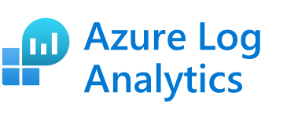
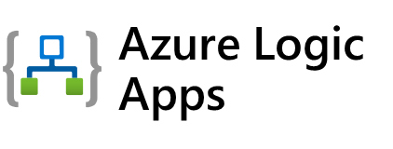

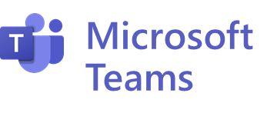


Respond and automate
Leverage “Quick Fixes” for the fastest way to implement recommendations
Automate threat alert responses with Azure Logic Apps and use the apps of your choice to create intelligent workflows
Connect to Microsoft Sentinel and easily move between the portals when investigating and managing incidents
Microsoft Sentinel
Notes:
Quick Fix for bulk resources With the many tasks that a user is given as part of Secure Score, the ability to effectively remediate issues across a large fleet can become challenging.
In order to simplify remediation of security misconfigurations and to be able to quickly remediate recommendations on a bulk of resources and improve your secure score use Quick Fix remediation.
This operation will allow you to select the resources you want to apply the remediation to and launch a remediation action that will configure the setting on your behalf.
Quick fix is generally available today customers as part of the recommendations blade.
Workflow automation with Logic Apps
Organizations with centrally managed security and IT/operations implement internal workflow processes to drive required action within the organization when discrepancies are discovered in their environments. In many cases these workflows are repeatable processes and automation can greatly reduce overhead streamline processes within the organization.
Create automation configurations leveraging Azure Logic Apps and to create policies that will automatically trigger them based on specific findings such as Recommendations or Alerts. Azure Logic App can be configured to do any custom action supported by the vast community of Logic App connectors or use one of the provided templates.
Advanced integrations with export of Defender for Cloud recommendations and alerts In order to enable enterprise level scenarios, we enable you to consume alerts and recommendations in additional places except the Azure Portal or API. These can be directly exported to an Event Hub and to Log Analytics workspaces. Here are a few examples of workflows you can create around these new capabilities:
With Export to Log Analytics workspace, you can create custom dashboards with PowerBI.
Use the native integration to Microsoft Sentinel
- With Export to Event Hub, you will be able to export alerts and recommendations to your 3rd party SIEMs, to a 3rd party solution in real-time, or Azure Data Explorer.

Slide 20
Demo

Slide 21
Microsoft Defender for Cloud dashboard
Microsoft Defender for Cloud dashboard
Notes:
New UI will launch at the end of March

Slide 22
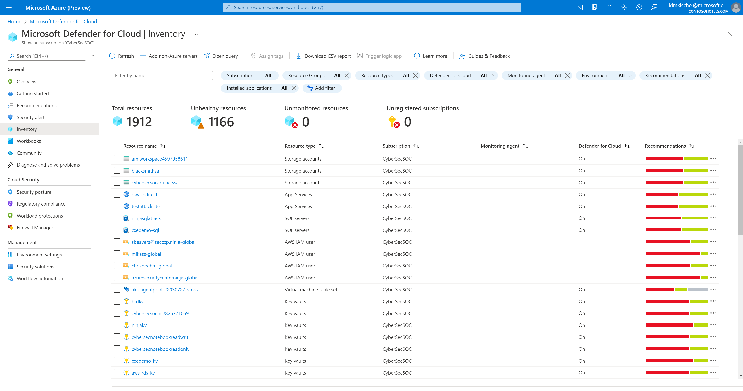
Resource Inventory

Slide 23
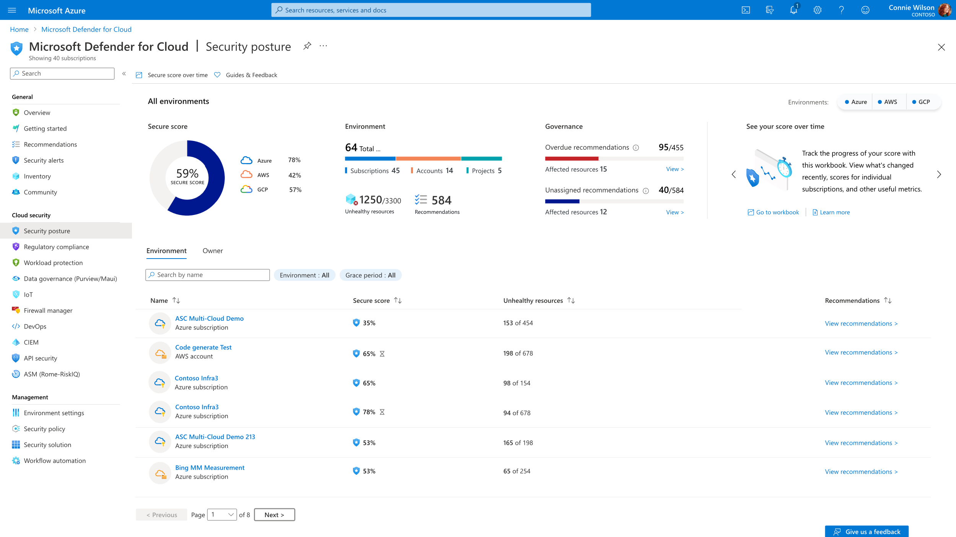
Secure Score dashboard
Secure Score dashboard
Notes:
New UI will launch at the end of March

Slide 24
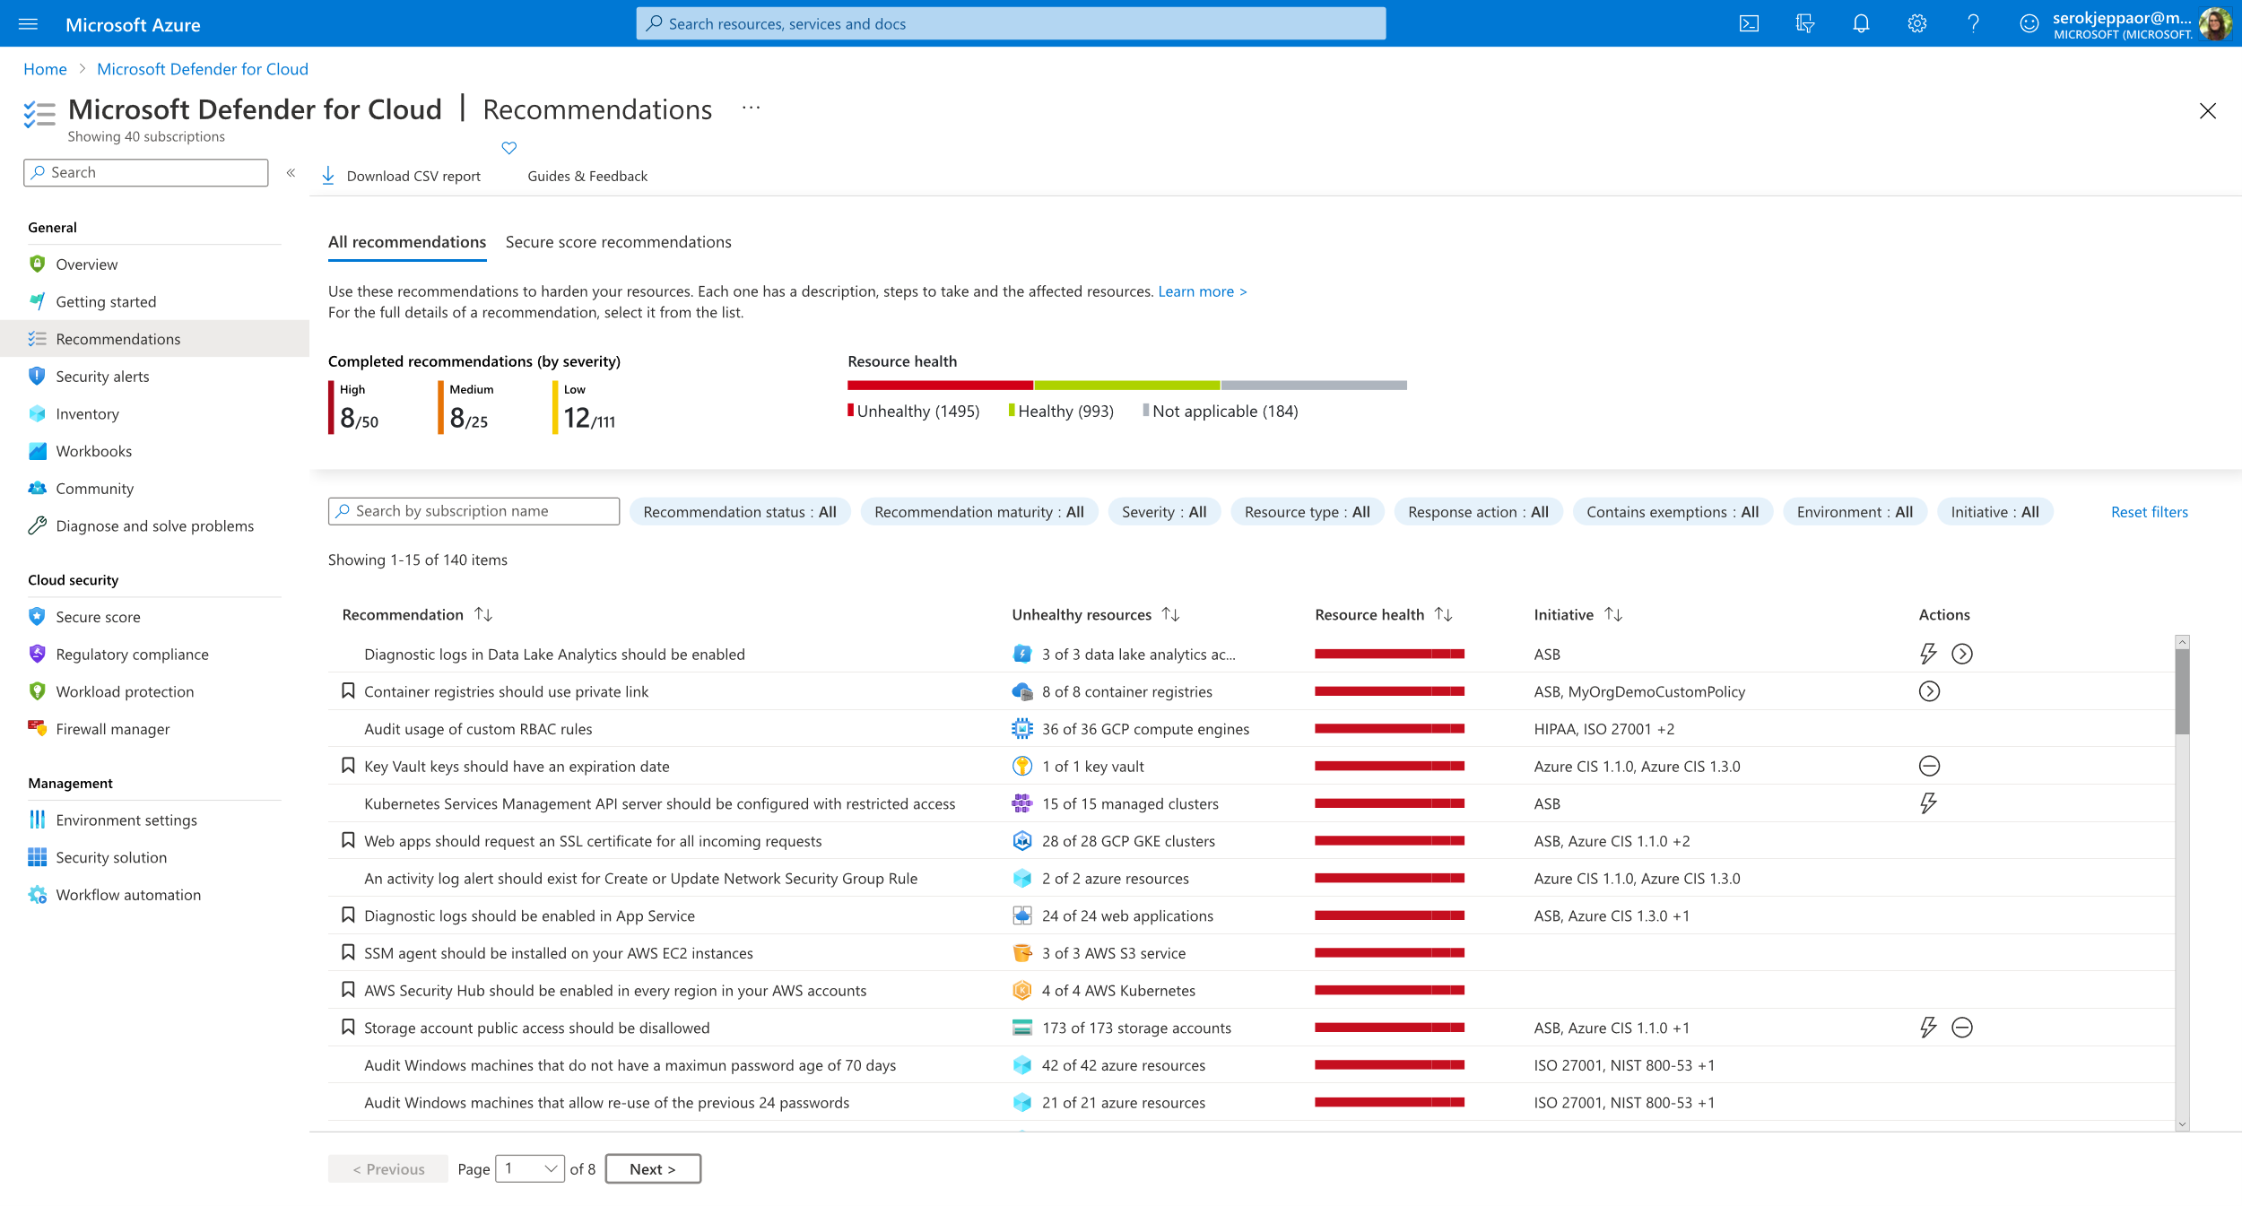
Multicloud recommendations blade
Multicloud recommendations

Slide 25
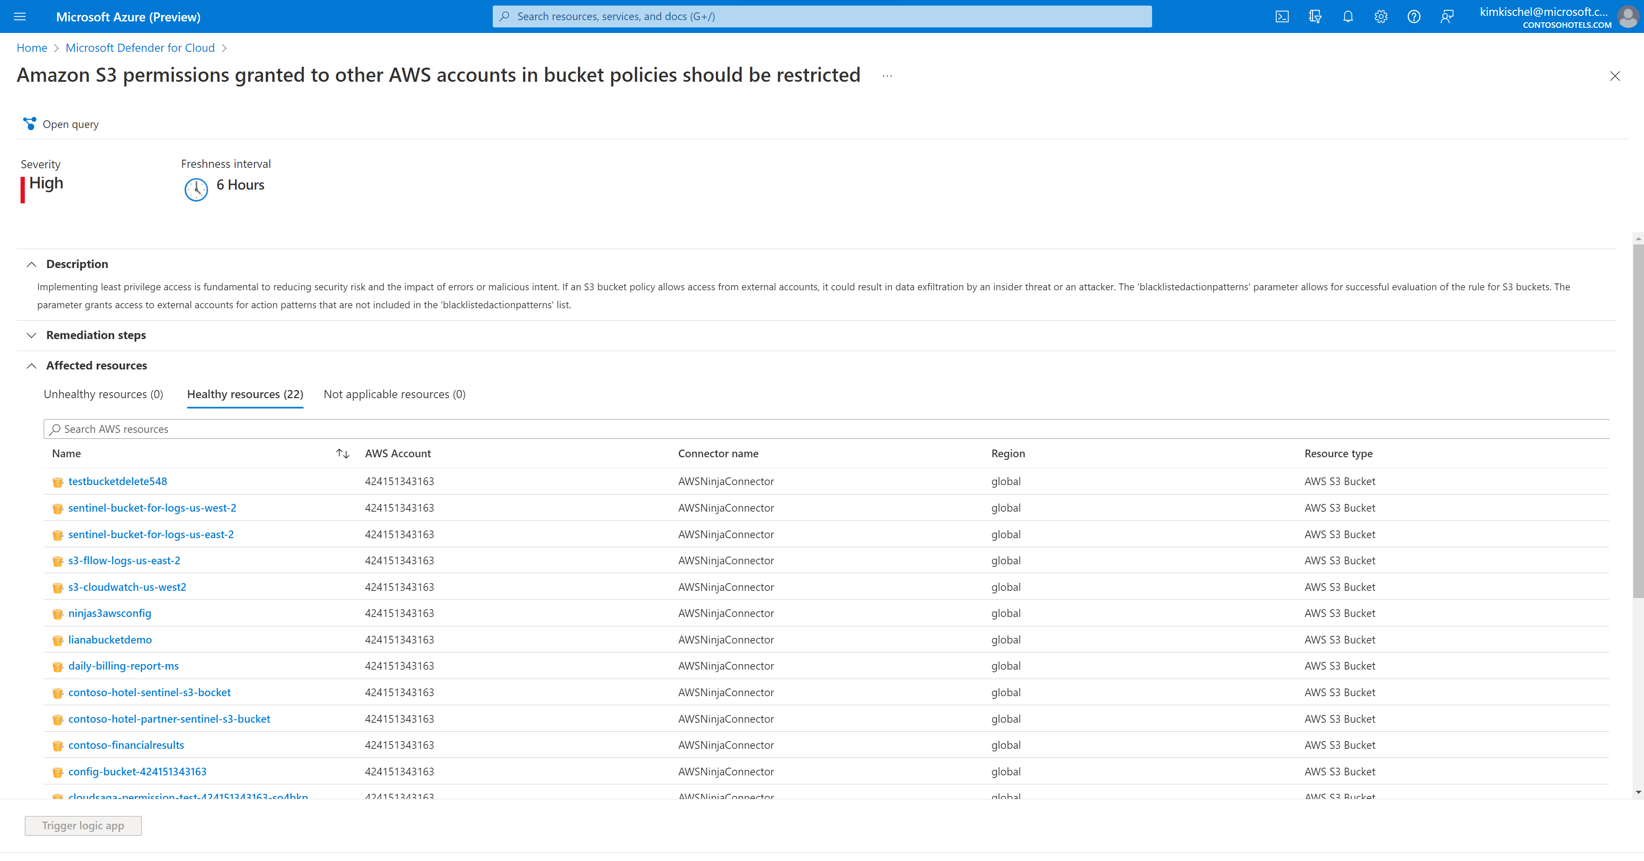
Recommendation details view

Slide 26
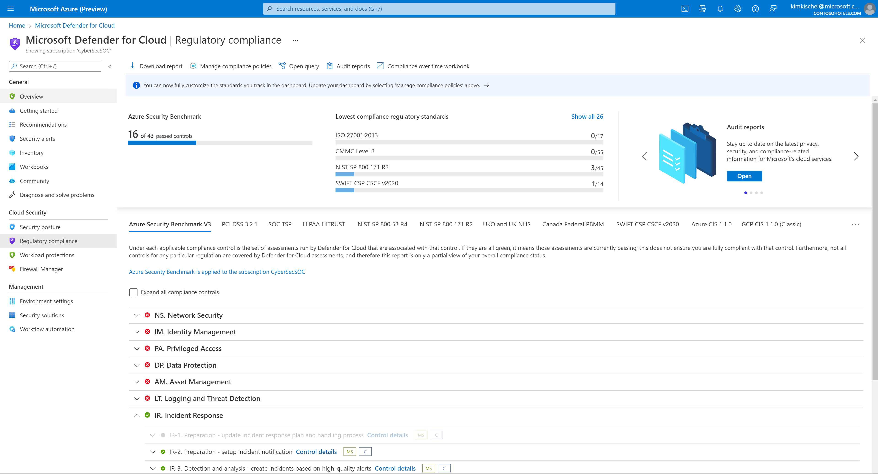
Regulatory Compliance view

Slide 27
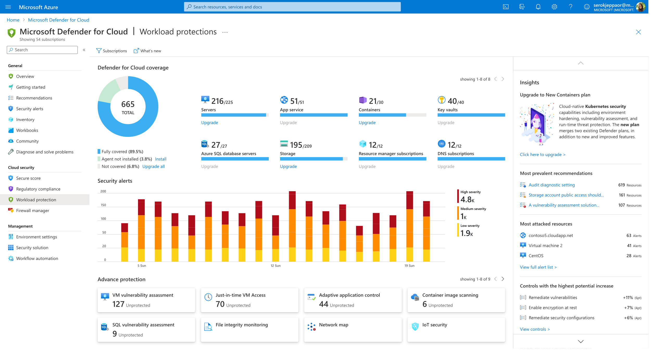
Workload protection overview
Workload protection overview

Slide 28
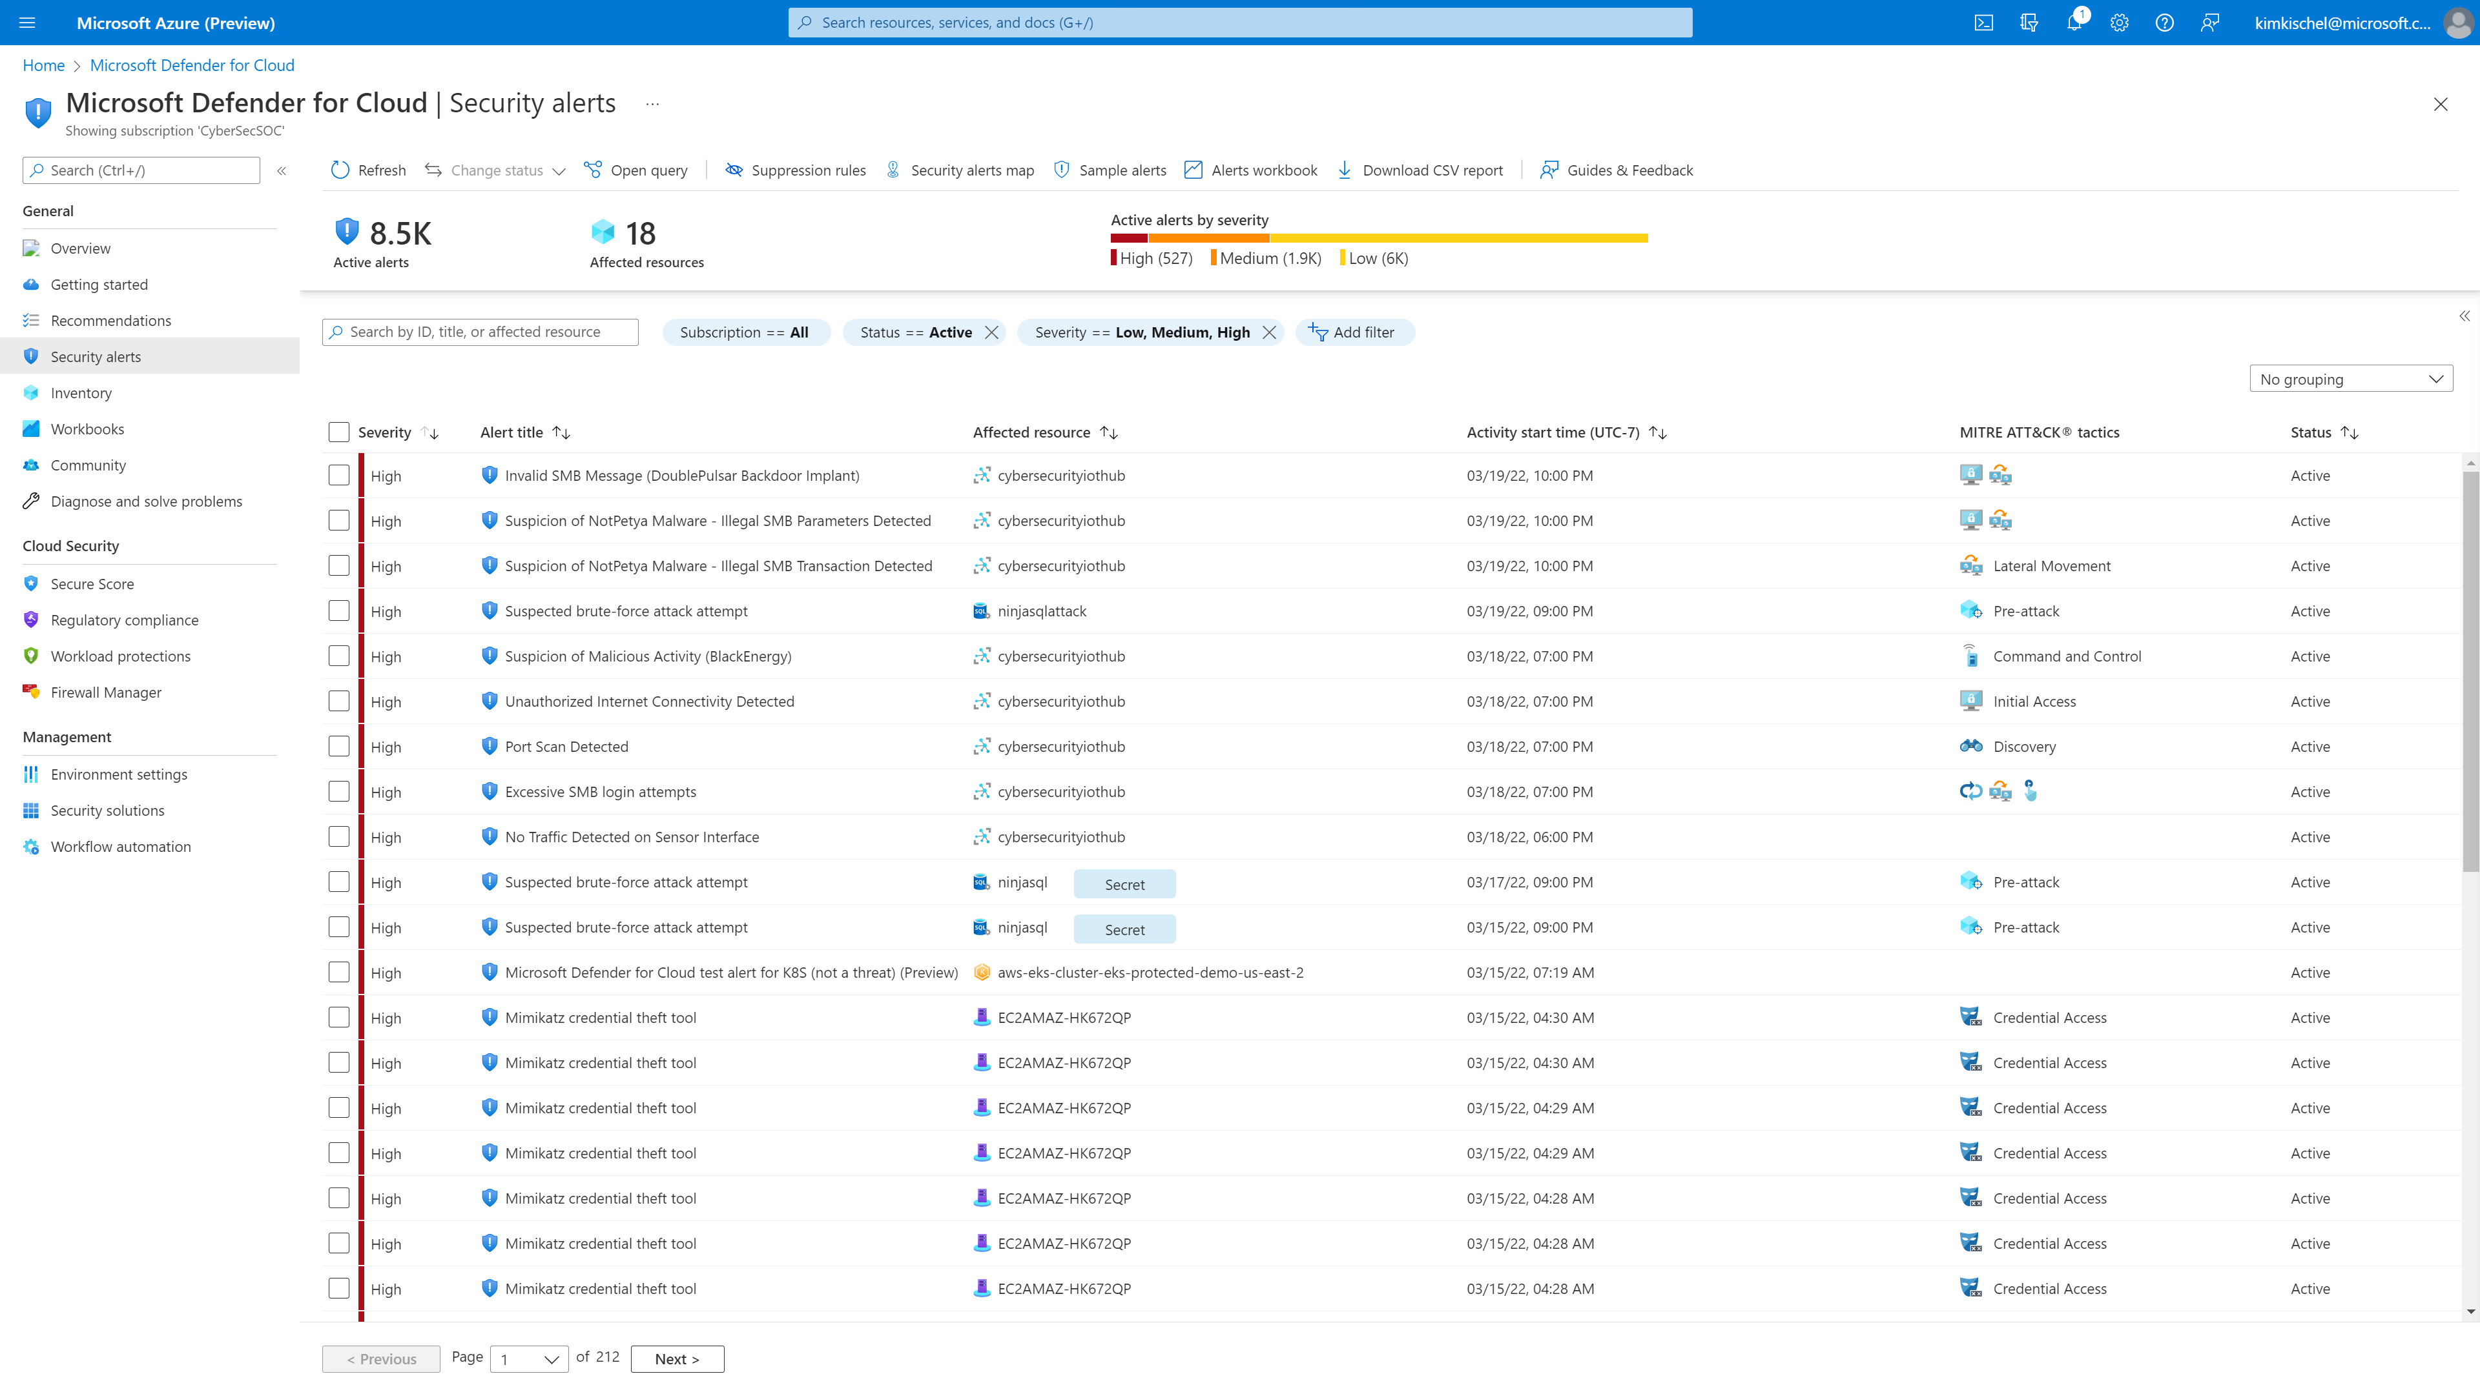
Security Alerts view
Security Alerts view

Slide 29
Thank you!

